Slide 1
SChat – A Secure Chat
By Ezra Block and Shy Tennenbaum Directed by Dr. Ariel Stulman and Aaron Slutsky Semester B – 2017 – Fundamentals For Network Security

Slide 2
Introduction
Communication in the 21st Century
Root of trust problem
SChat – One chat to rule (secure?) them all…

Slide 3
Functionality of the SChat protocol
Register your username
Go online (connect request)
Wait for incoming chat request
Start a chat with a fellow user

Slide 4
Registration Process:
Alice
Server (TTP)
Encrypted with the public key of TTP with RSA
“Alice”, symmetric key K1, nounce
Encrypted with Alice’s private key with AES
nounce -1

Slide 5
Registration Process:
Authenticity
Anonymity
Confidentiality
Uses a known secret (the public key of the server)

Slide 6
Connection Process:
Alice
Server (TTP)
Encrypted with the public key of TTP with RSA
“Alice”, “Alice”, current-time t1
Encrypted with K1 with AES
token-time t1

Slide 7
Connection Process:
Authenticity
Anonymity
Time limit

Slide 8
Opening Chat Process
The chat opening process is in two steps:
Step 1: Alice – TTP – Get Info
Step 2: Alice – Bob – Handshake

Slide 9
Open Chat - Step 1 Get Info
Alice
Server (TTP)
Encrypted with Alice’s private key with AES
Encrypted with the public key of TTP with RSA
“Alice”, “Bob”, nounce n1
Encrypted with Bob’s private key with AES
IP-Bob, Shared-key sk, nounce n1,
“Alice”, Shared-key sk
This will be used in the next step – called “token”

Slide 10
Get Info Process:
Authenticity
Anonymity

Slide 11
Open Chat Step 1: Alice with Bob – Handshake
Alice
Bob
token
Hi:
“Alice”, Shared-key sk
Public key DH –Alice,
Nounce n2
Encrypted with shared-key sk
Nounce n2, Public key DH –Bob,
OK:
Great (Gitarot):
Encrypted with DH shared key using AES
nounce n2 + 1

Slide 12
Establishing Secure Chat Process:
Authenticity
Confidentiality
Perfect Forward Secrecy (PFS)

Slide 13
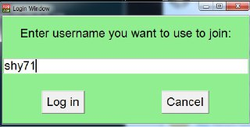
Login Window:

Slide 14
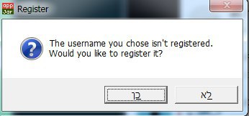
In case the chosen username isn’t registered to the system:

Slide 15
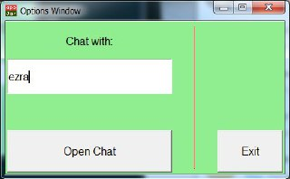
After entering as a user from the login:

Slide 16
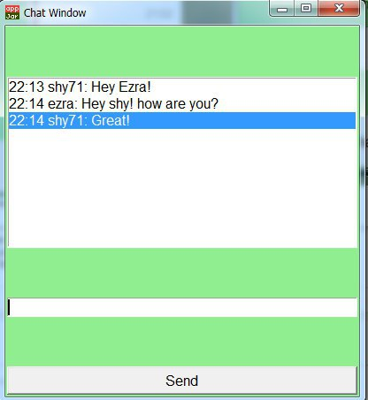
Then the chat window is opened:

Slide 17
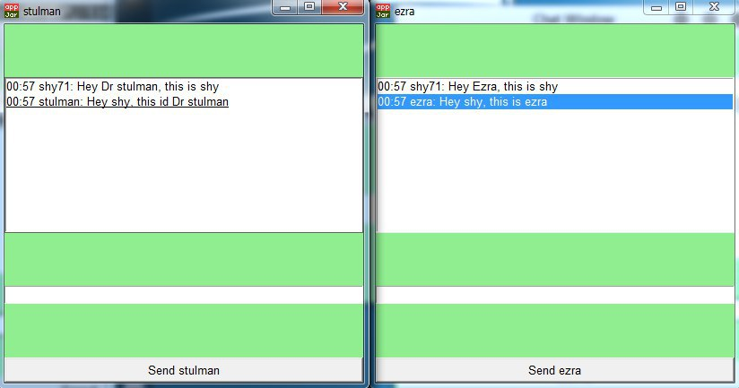
A few chats can be opened simultaneously from the previous window!

Slide 18
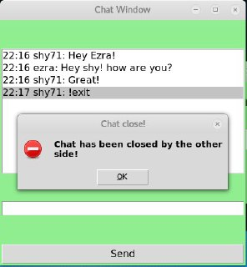
When one side terminates the chat. The other side gets the following message:

Slide 19
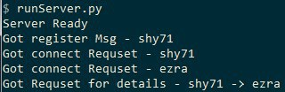
The Server (TTP) Window:

Slide 20


Slide 21


Slide 22


